Slide 1
Comfort Control

Slide 2
Team Members
Wesley Swink
Team Lead Thermostat hardware design-Lead Vent design
Drew Fountain
Vent design-Lead Thermostat hardware design Temperature probe design

Slide 3
Team Members
Jordan Freeman
Programming-Lead User interface Mobile application design
Nathan Wang
Mobile application design-Lead Programming Website design-Lead

Slide 4

Faculty Advisor
Dr. Randy Follett
Ph.D., Electrical Engineering, Mississippi State University, 1988
M.S., Electrical Engineering, Mississippi State University, 1984
B.S., Electrical Engineering, Mississippi State University, 1982
Academic/Research and Fields of Interest:
System Simulation
Digital Control Systems
Sonar Signal Processing
Computer-Aided Control Systems analysis and Design
Research/Organization Affiliations:
Eta Kappa Nu Electrical Engineering Honorary Society (HKN)

Slide 5
Agenda
Problem
Solution
Constraints
Technical
Practical
Approach
Progress
Timeline
Questions

Slide 6
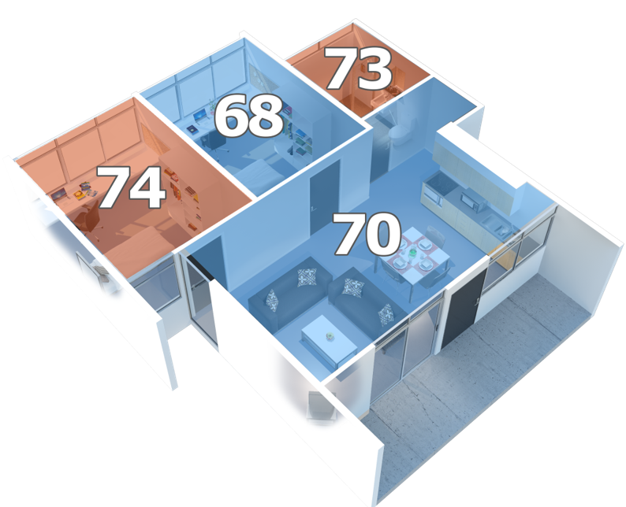
What’s the Problem?
Inconsistent temperatures throughout the household
No personalization
Manual vents
Undesired temperatures

Slide 7
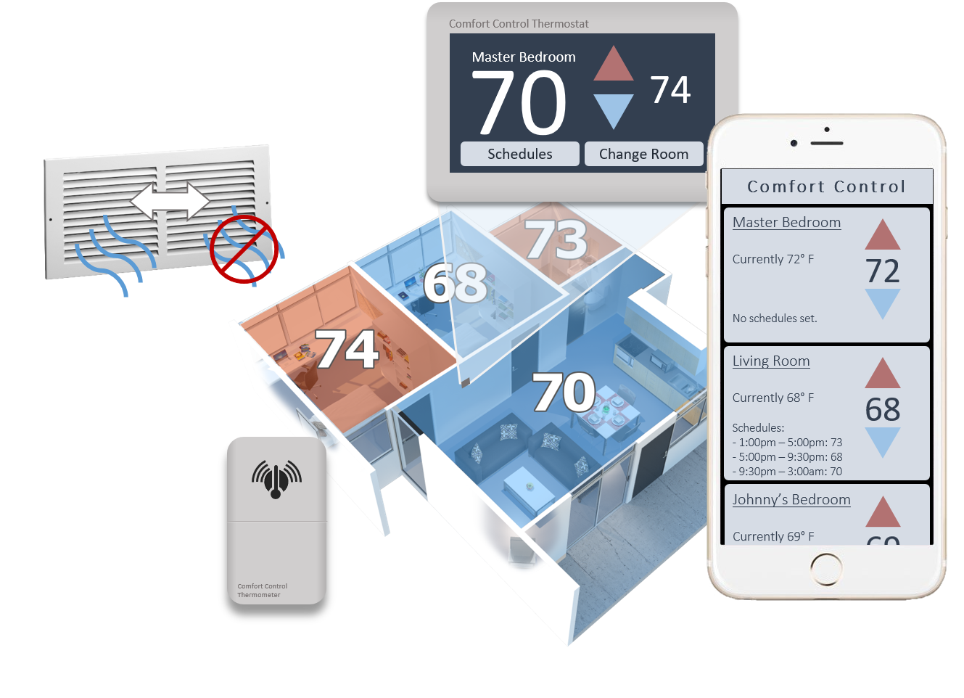
Solution
Personalized comfort in every room
Automated Vents
On-the-go control

Slide 8
Constraints

Slide 9
Technical Constraints
Name | Description
Range | The Comfort Control thermostat hub must maintain connection with the Wi-Fi router and each room’s thermometer probe, which can reach up to 70 feet apart in an average household.
Air Flow | The Comfort Control vents must open by at least 0.5 inches to allow for adequate airflow.
Integration | The Comfort Control thermostat must operate with existing thermostat connections.
Size | The Comfort Control system must monitor and control the climate of at least ten devices.
Accuracy | The Comfort Control thermometers must read accurate temperatures within half of a degree Fahrenheit.

Slide 10

Practical Constraints
Economic
Main Competitor - Ecovent
Comfort Control basic package $200
Less than $100 for additional vent and thermometer probe

Slide 11

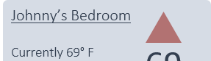
Practical constraints
Comfort Control
Social
Mobile device application
Easy-to-use interface
Powerful control
Master Bedroom
Currently 72° F
No schedules set.
Master Bedroom
Currently 72° F
No schedules set.
72
Living Room
Currently 68° F
Schedules: - 1:00pm – 5:00pm: 73
- 5:00pm – 9:30pm: 68
- 9:30pm – 3:00am: 70
68

Slide 12
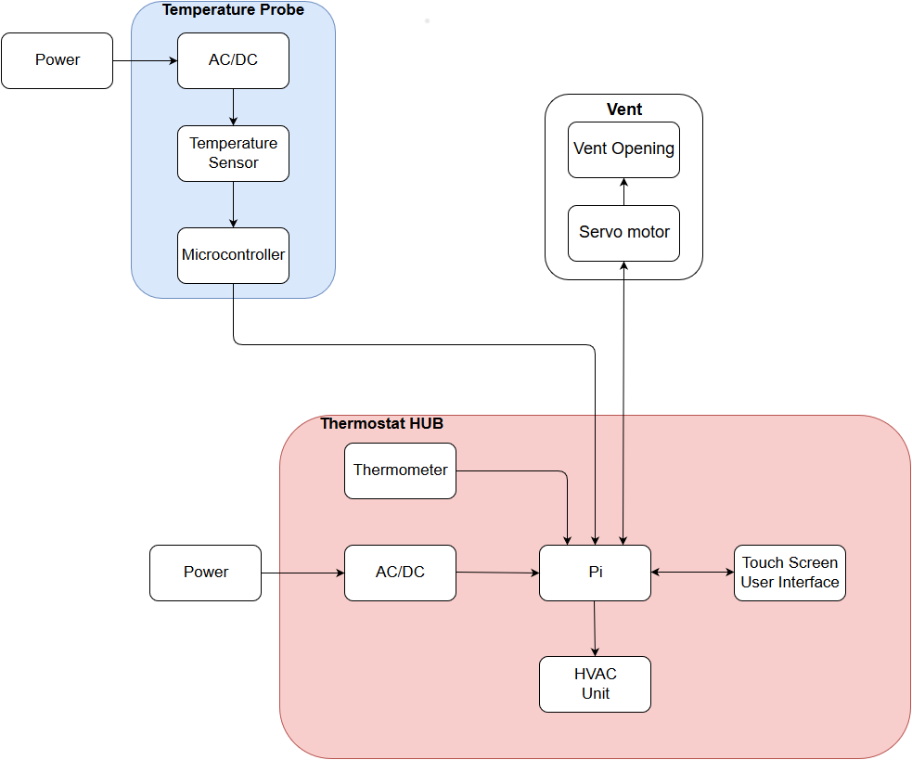
Approach
Microcontroller
Temperature Probes
Wifi Modules
DC-DC Converter
Relay Module
Touchscreen

Slide 13
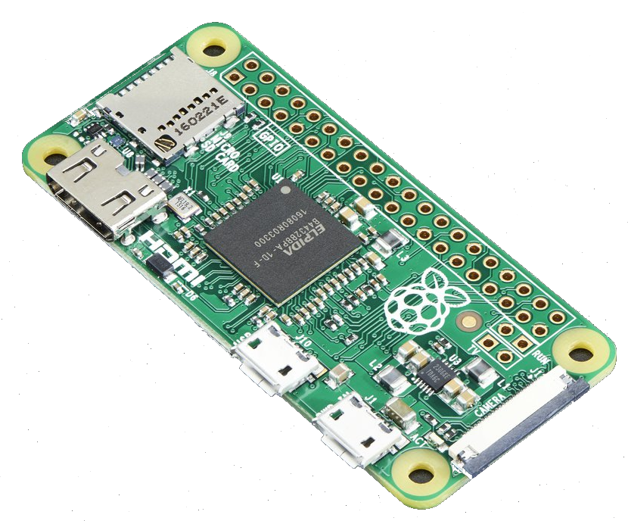
Microcontroller
Raspberry Pi Zero
Will be built into the thermostat to control:
GUI
App Communication
Room temperature retrieval
Opening and closing of vents
Notes:
https://www.adafruit.com/product/2885

Slide 14
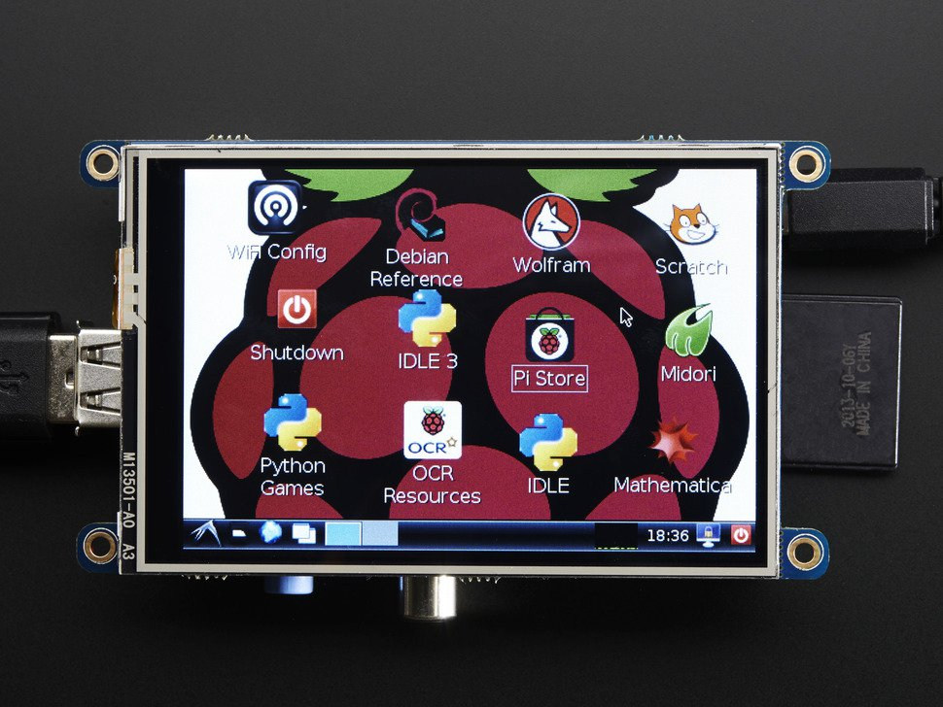
Touchscreen
3.5” Display
480 x 320 resolution
Max current of 100mA
Notes:
https://www.adafruit.com/product/2097

Slide 15
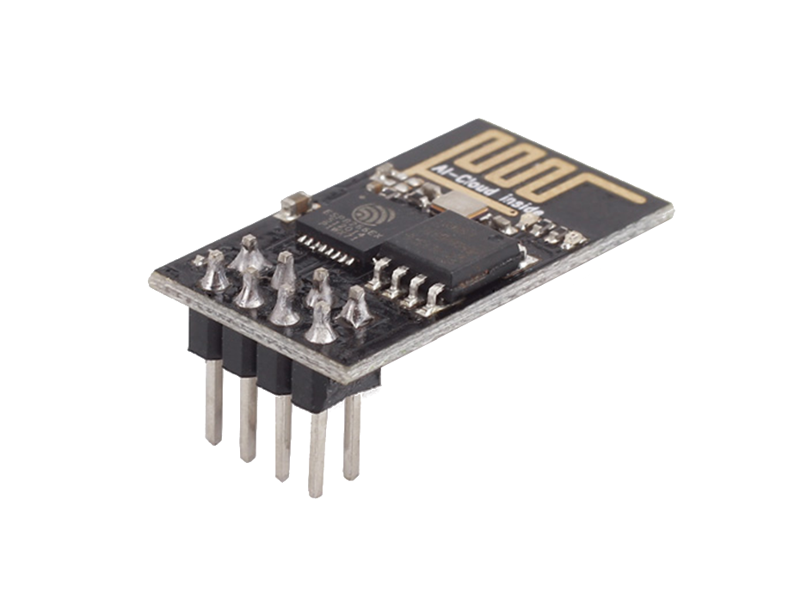
Microprocessor and Wifi Module
WiFi Serial Transceiver Module with ESP8266
Built into thermometer probe to communicate room temperature to thermostat over WiFi
Notes:
https://www.seeedstudio.com/WiFi-Serial-Transceiver-Module-w-ESP8266-p-2485.html?ref=newInBazaar

Slide 16
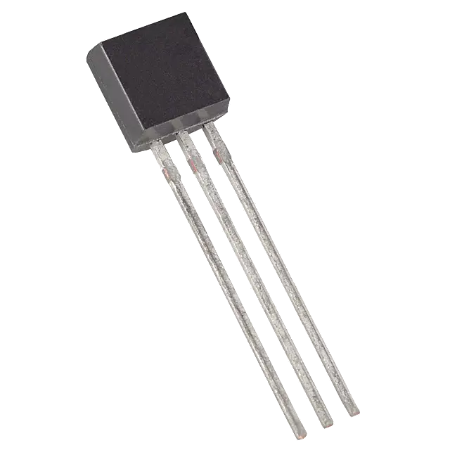
Temperature Sensor
Component | Pros | Cons
DS18B20 | Digital Can connect directly to Raspberry Pi Single connection | Larger
Thermistor | Small Single connection | Analog Cannot connect directly to Raspberry Pi
MCP9808 | Most accurate | Price Largest Most connections

Slide 17
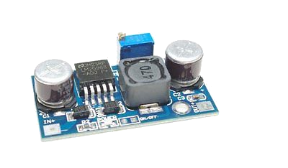
DC-DC Converter
Component | Pros | Cons
SMAKN LM2596 DC-DC Converter | Max input voltage Price High load current | Large
DROK LM2596 Numerical Control DC-DC Converter | Price LED display | Largest footprint Input voltage
TRACO Power TSR-1-2450 | Fixed 5v output Small footprint | Lowest load current Price

Slide 18
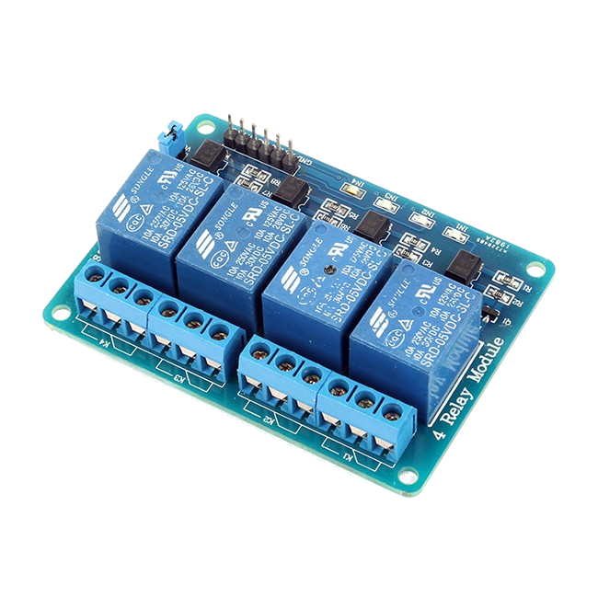
Relay Module
Component | Relay Voltage | Contact Rating | Price
SainSmart 4 Channel Relay | 5VDC | 250VAC-10A 30VDC-10A | $8.79
JBtek 4 Channel Relay | 5VDC | 250VAC-10A 30VDC-10A | $6.99
Foxnovo 4 Channel Relay | 5VDC | 250VAC-10A 30VDC-10A | $7.69

Slide 19
Progress
Parts selected and purchased
Mobile application design
GUI design
Hardware testing
Relay
Servo
Raspberry PI
Vent design

Slide 20
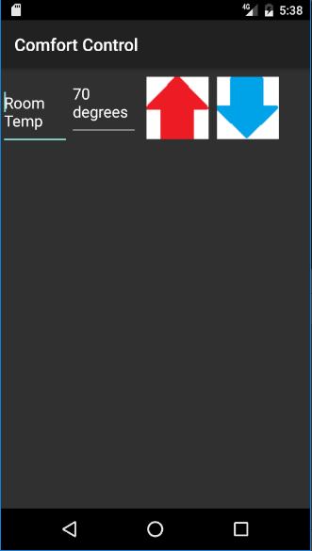
Mobile Application Design
Comfort Control
Overall Goal
Generic user interface
Intuitive and simple
Log in screen
Communication with thermostat
Currently
Formatting temperature control screen
Master Bedroom
Currently 72° F
No schedules set.
Master Bedroom
Currently 72° F
No schedules set.
72
72
Living Room
Currently 68° F
Schedules: - 1:00pm – 5:00pm: 73
- 5:00pm – 9:30pm: 68
- 9:30pm – 3:00am: 70
68
Goal GUI
Current GUI
Notes:
http://www.instructables.com/id/ESP8266-WiFi-DB18B20-temperature-sensor-ESP8266-Ar/?ALLSTEPS

Slide 21
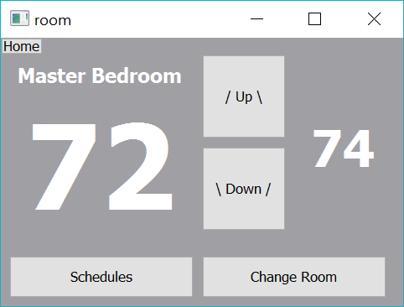
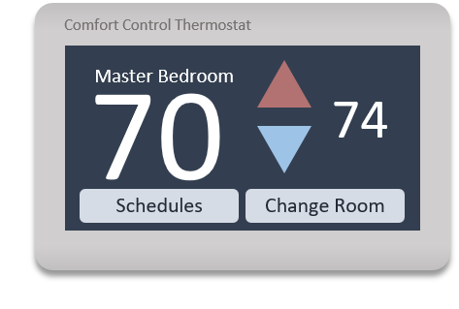
GUI Design
Current GUI >
Basic framework
Window navigation
Functioning buttons
< Goal GUI

Slide 22
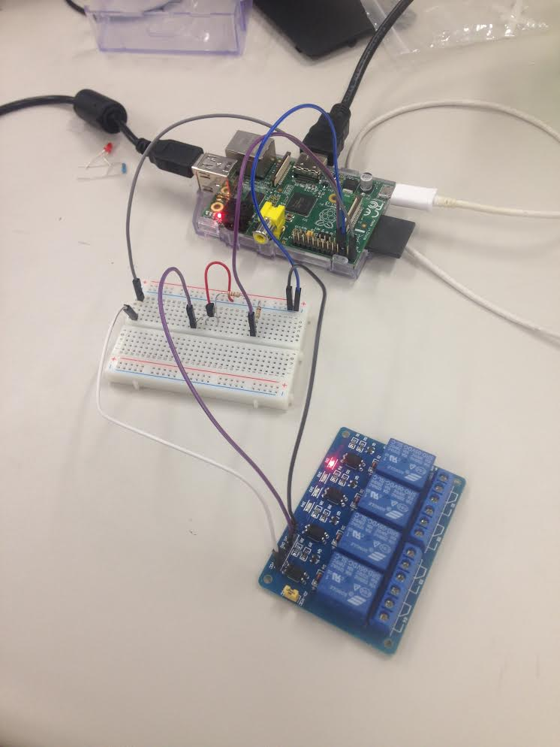
Hardware Testing
Successfully controlled solid state relay with Raspberry Pi
Successfully connected and controlled servo motor with Raspberry Pi

Slide 23
Timeline
August
Begin researching
September
Begin selecting parts
Start on application and thermostat GUI and front end
Finalize vent and temperature probe design
Begin testing parts
October
Start on application and thermostat backend
Create physical vent and temperature probe prototypes
November
Integrate all parts of system
Begin system testing

Slide 24
References
[1] Amazon.com, "SMAKN LM2596 DC-DC Buck Converter", 2016. [Online]. Available:
https://images-na.ssl-images-amazon.com/images/I/71gQyHR8llL._SL1500_.jpg [Accessed: September 16, 2016]
[2] Amazon.com, "JBtek 4 Channel 5V DC Relay Module", 2016. [Online]. Available:
https://images-na.ssl-images-amazon.com/images/I/712o-J5AgcL._SL1100_.jpg [Accessed: September 16, 2016]
[3] Adafruit.com, "Raspberry Pi Zero - Version 1.3" [Online]. Available:
https://www.adafruit.com/product/2885
[4] Adafruit.com, "PiTFT - Assembled 480x320 3.5" TFT+Touchscreen for Raspberry Pi", 2016. [Online]. Available:
https://www.adafruit.com/products/2097
[5] seeedstudio.com. "WiFi Serial Transceiver Module w& ESP8266", 2016. [Online]. Available:
https://www.seeedstudio.com/WiFi-Serial-Transceiver-Module-w-ESP8266-p-1994.html
[6] sparkfun.com. "One Wire Digital Temperature Sensor - DS18B20", 2016. [Online]. Available:
https://www.sparkfun.com/products/245

Slide 25
Questions

